Slide 1
Introduction to Computer Vision
4. Color spaces. Segmentation
14.11.22
Mikhail Belyaev

Slide 2
Outline
Colors
Edge-based & region-based segmentation
Superpixels
Homework 1

Slide 3
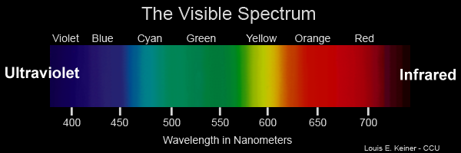
Color. Physics
How do colors exist in nature? We know that EM waves of different wavelength can be observed with the following colors. Are those the colors we see?

Slide 4
Color. Physics
How do colors exist in nature? We know that EM waves of different wavelength can be observed with the following colors. Are those the colors we see?
Not exactly. We see (1) a combination of EM (2) with our eyes

Slide 5
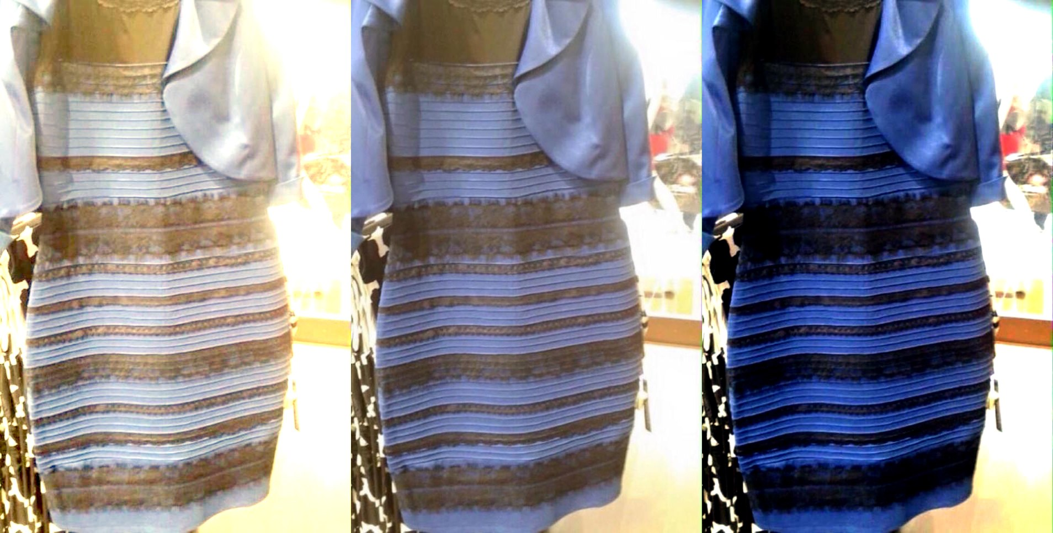
How do humans perceive images?
Image perception is subjective: different people will see this dress (left) either as blue and black or as white and brown.

Slide 6
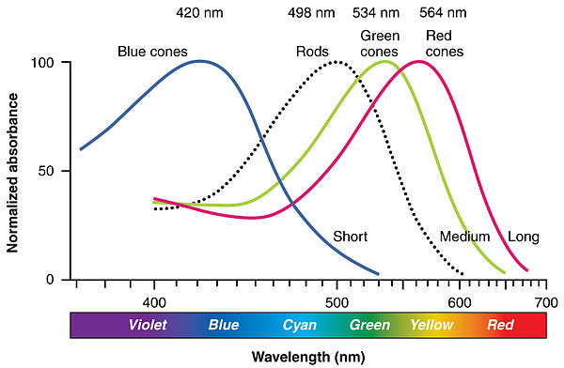
Eyes
Human eyes has cones and rods for distinguishing colors.
Rod cells are responsible for black&white vision in low-light environment
Cone cells are of 3 types with different responsivity

Slide 7
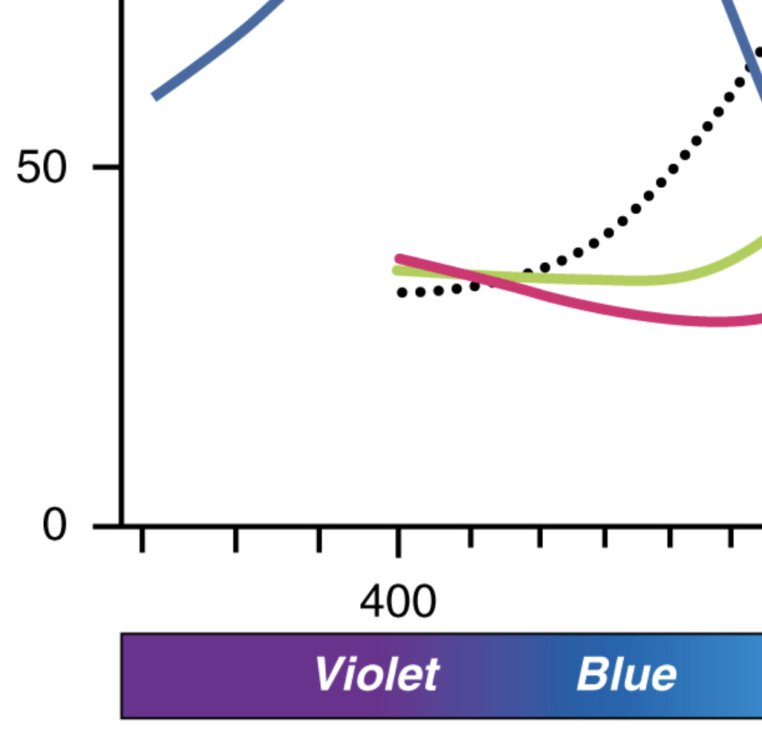
Eyes
Human brain is capable of computing different cones activations into colors as we know them.
Those complex absorbance curves can result in a mess.
Can you see the sudden rise of red cone response for waves with very short length?

Slide 8

Eyes
Because of it we see waves with length < 400nm as a combination of blue + red.
Most cameras don’t.
So it’s hard to make a good photo of a rainbow.
Violet color is captured as blue.

Slide 9
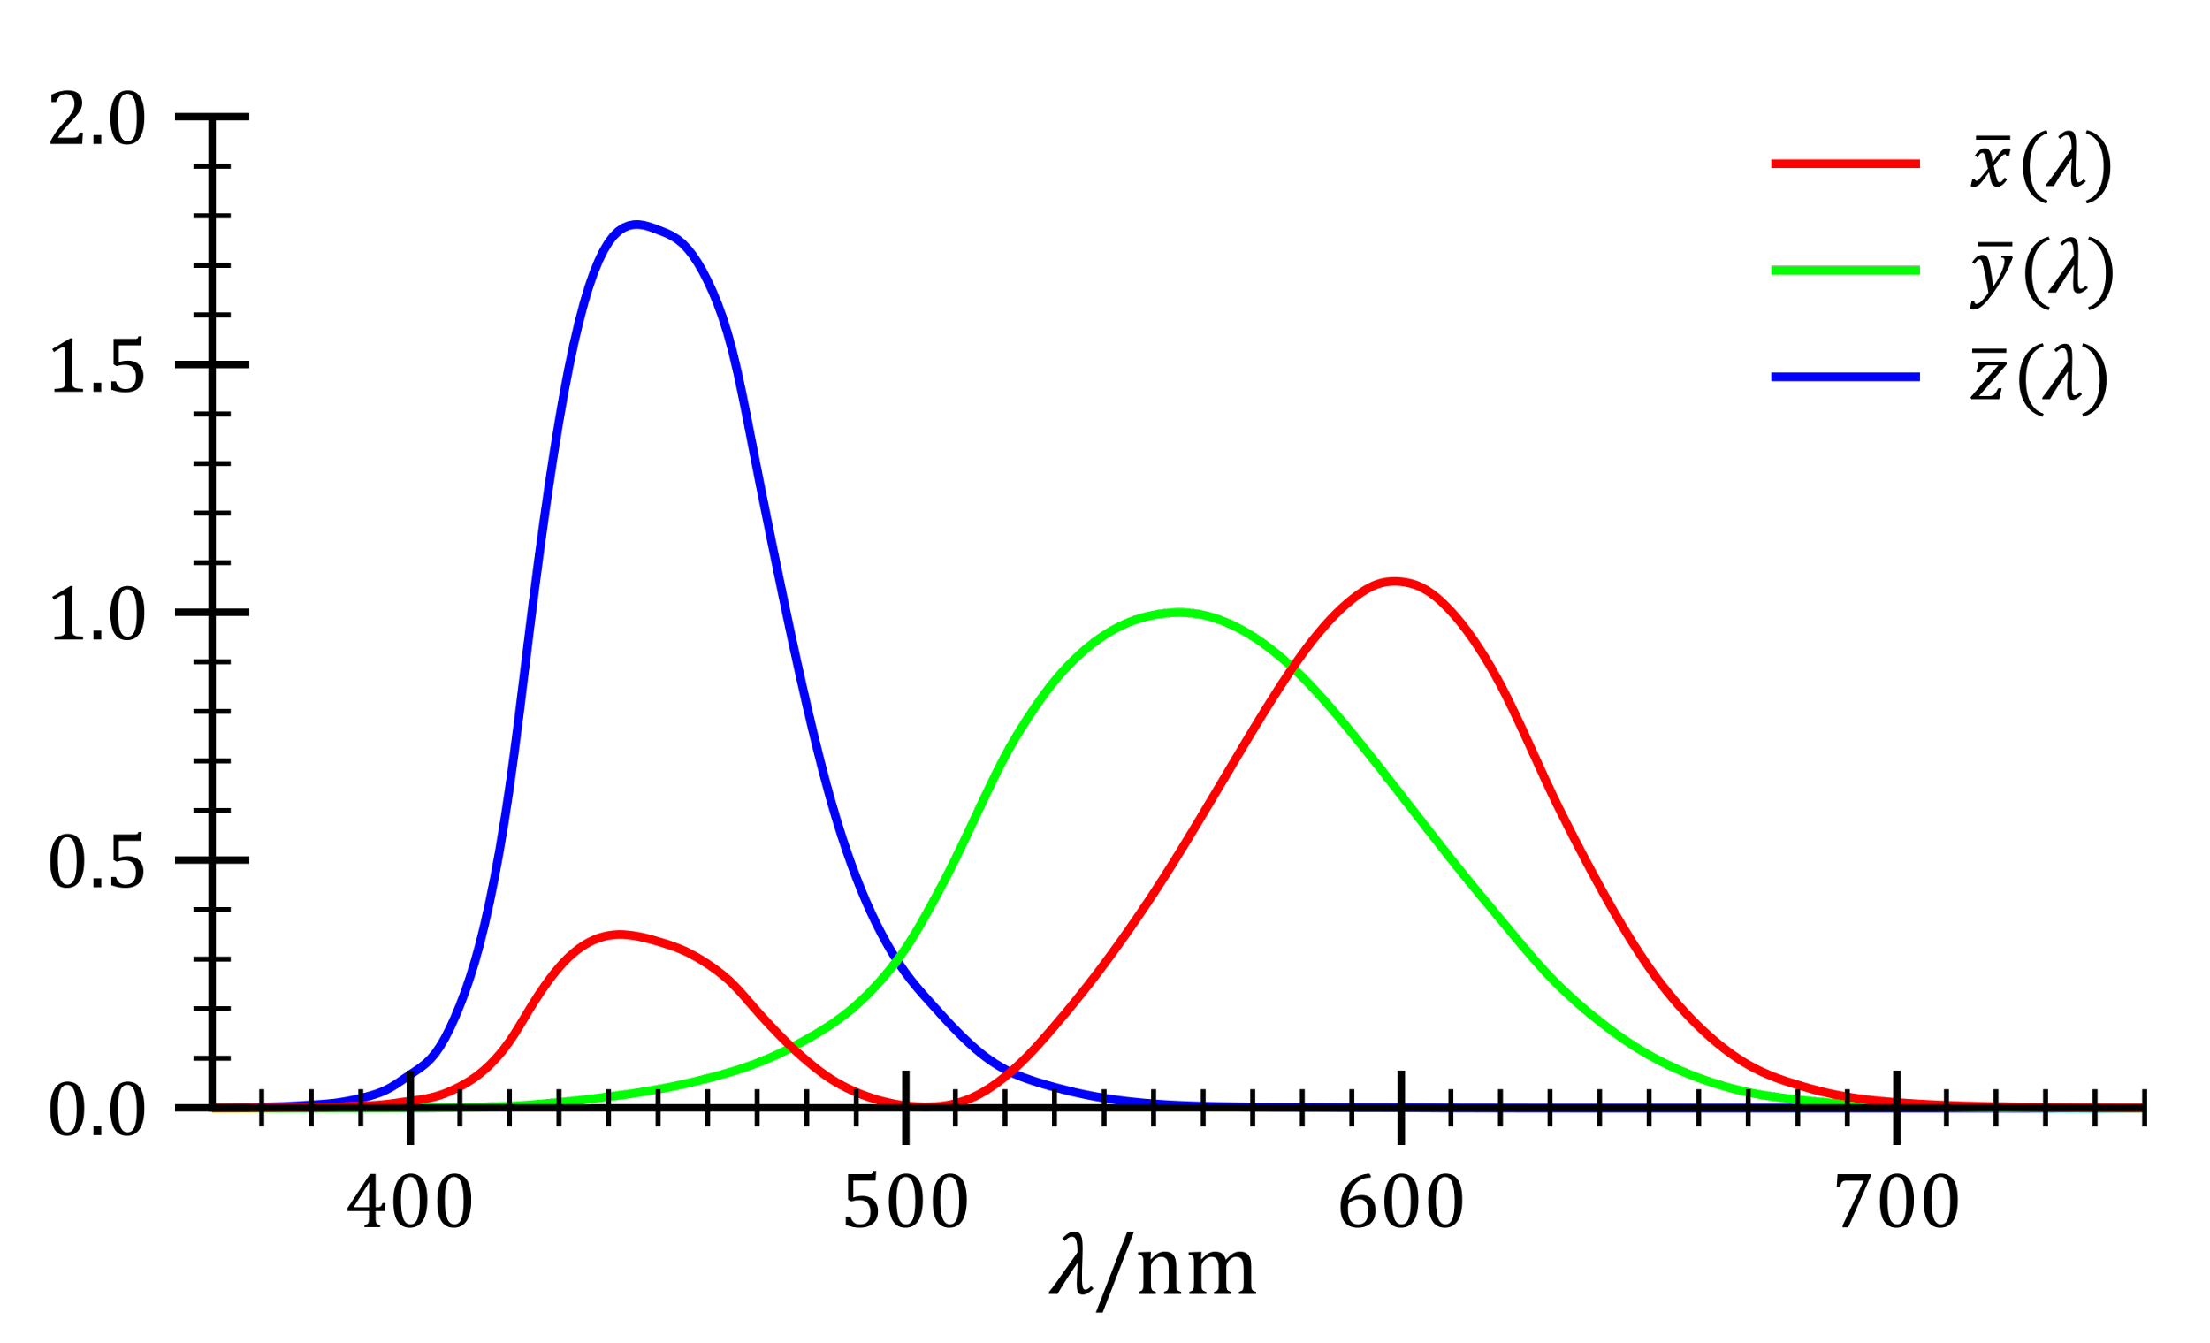
Color. CIE Space
By approximating cone activations with the shown functions we can gauge waves with 3 coordinates.

Slide 10
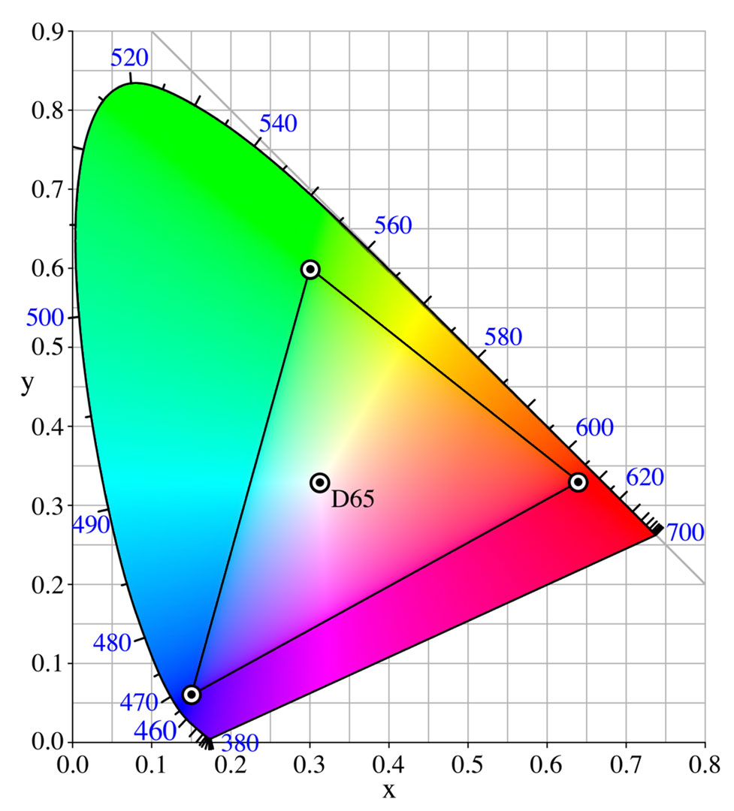
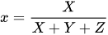
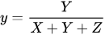
Color. CIE Space
Denote
where X, Y and Z are activations for the corresponding cones,
We can show the colors on a plane

Slide 11
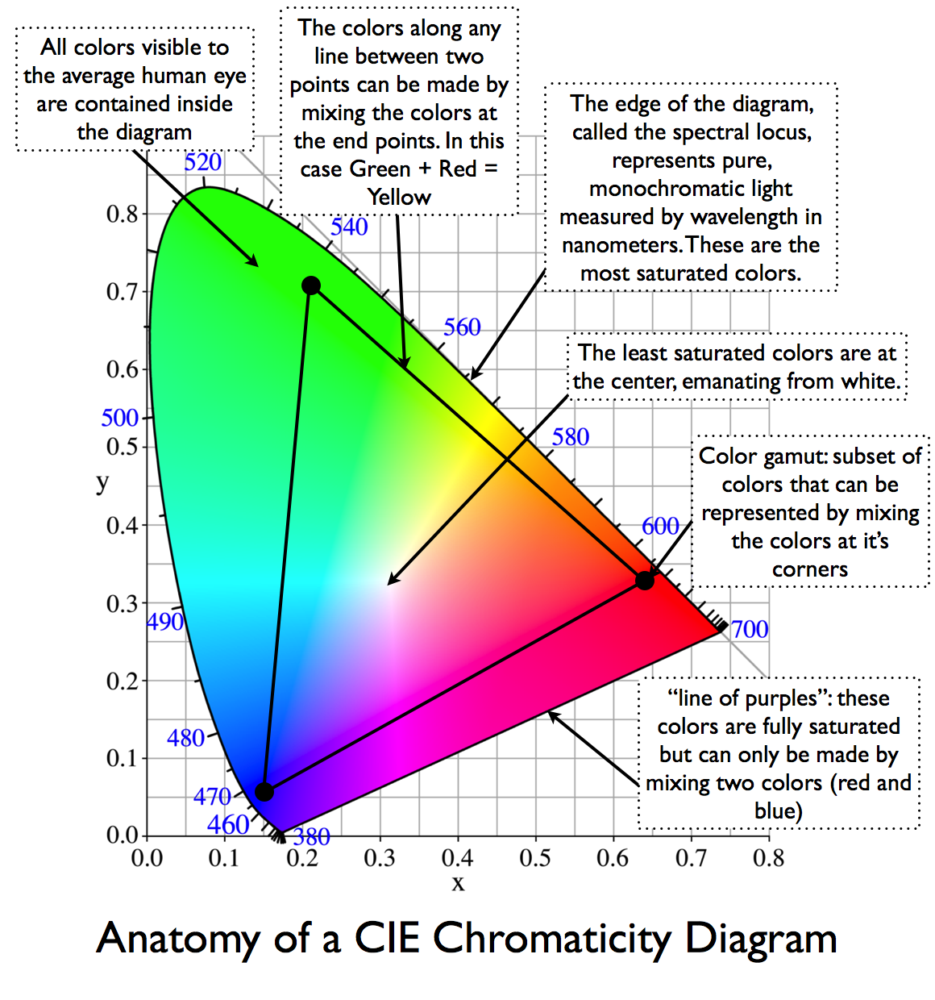
Color. CIE Space

Slide 12
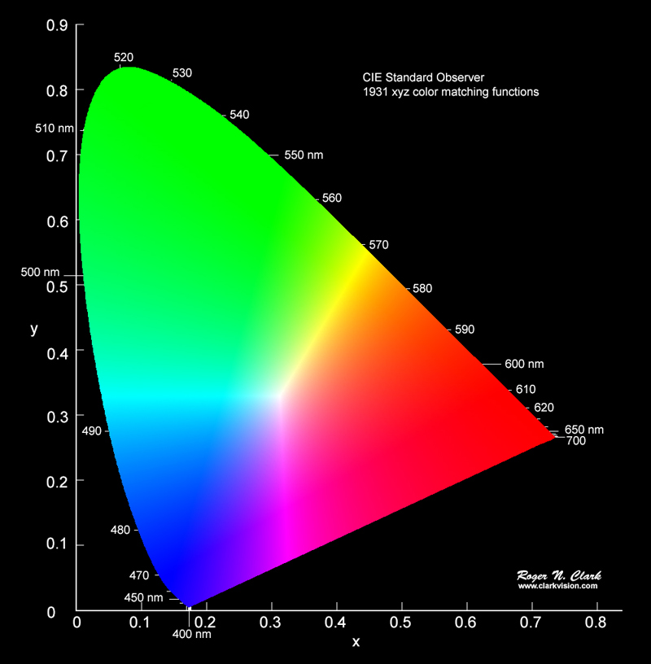

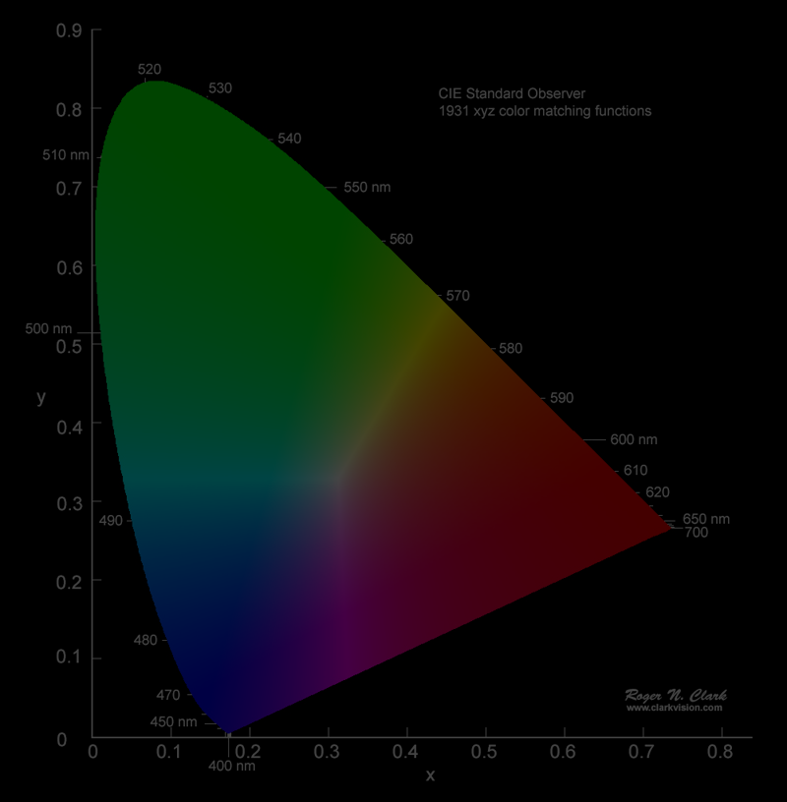
Color. Brightness
Are those all the colors?
No. They could be of a different brightness.

Slide 13
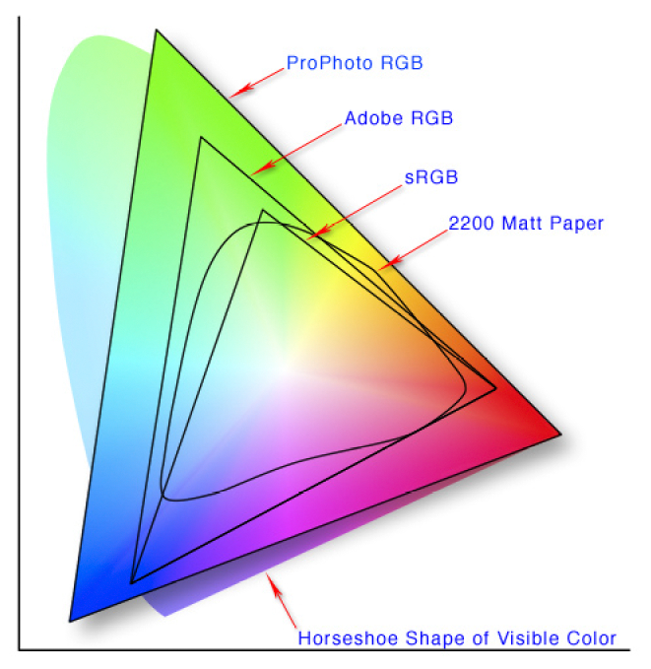
Color spaces
Color spaces are different 3d parameterization of XYZ CIE space.
Most known are RGBs
Each point in a RGB color space is a linear combination of vertices of some triangle (R, G, B)
C = a * R + b *G + c * B
Points with (a+b+c) = 1 are on this slide

Slide 14

Color. Brightness
Different intensity may produce new colors.
On the previous slide we call green a dot for both high and low brightness.
But brown color is the same as
orange with lower brightness
We can distinguish it only by
comparing with the other colors
It means that it’s not possible to create a light source of brown color.

Slide 15
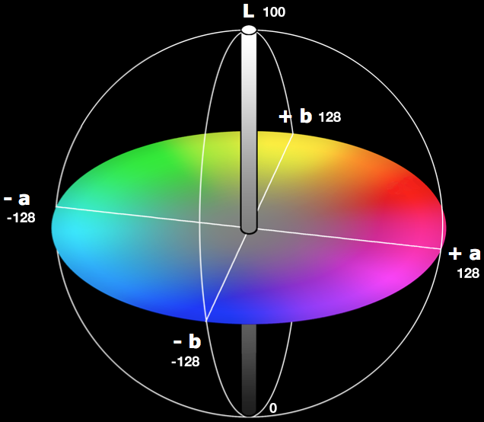
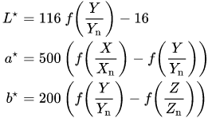
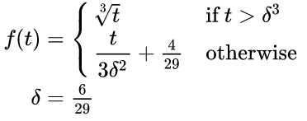
Color spaces. Lab (CIELAB)
Color spaces are different 3d parameterization of XYZ CIE space.
https://docs.esko.com/docs/en-us/imagingengine/14.1/userguide/home.html?q=en-us/common/ie/concept/co_ie_ChoosingColorTolerances.html
L* for the lightness from black (0) to white (100),
a* from green (−) to red (+),
b* from blue (−) to yellow (+)

Slide 16
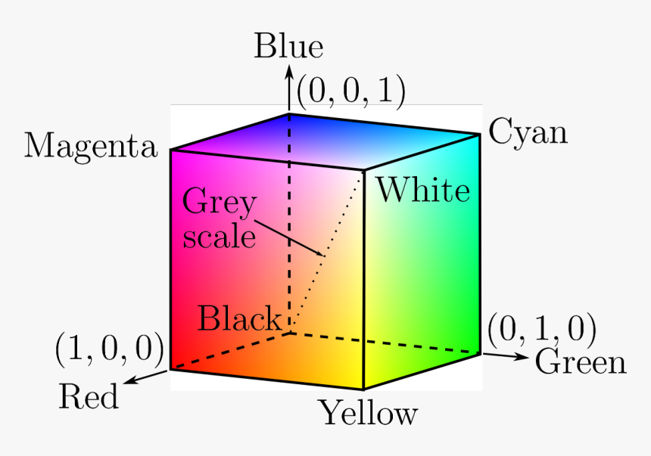

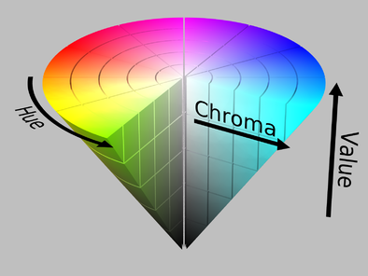
Color spaces. HSV, HSL
RGB color space is a cube
Other parametrizations may seem
more suitable for different applications
The most common examples are cylindrical and cone

Slide 17
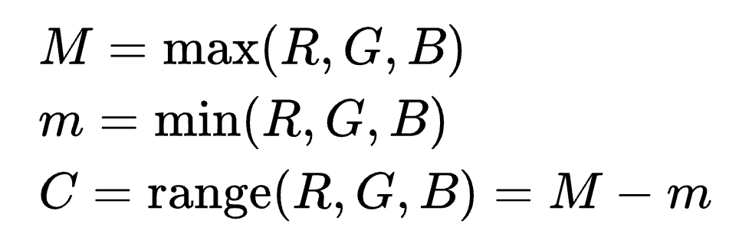
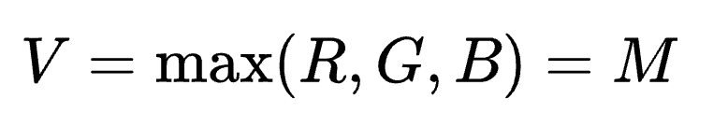
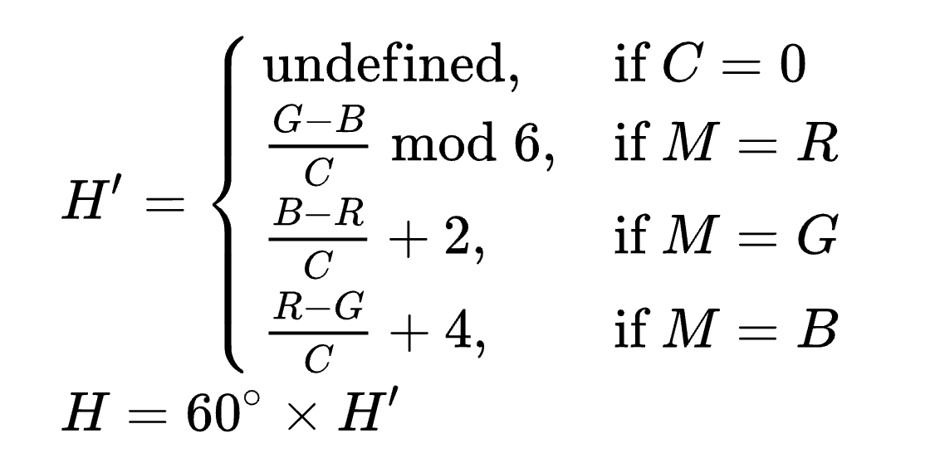
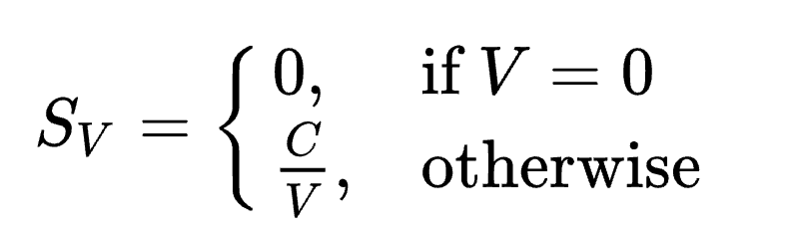
Color spaces. HSV
Value:
Saturation:
Hue:

Slide 18
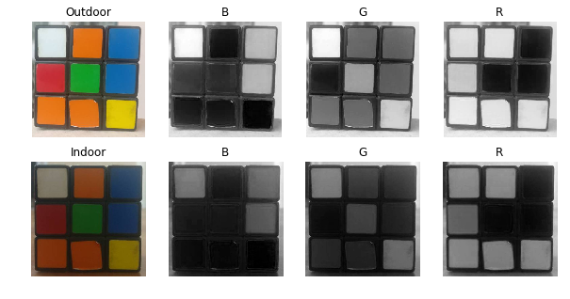
Color spaces. Practical aspect. RGB
A great tutorial at learnopencv: https://www.learnopencv.com/color-spaces-in-opencv-cpp-python/
significant perceptual non-uniformity.
mixing of chrominance (Color related information) and luminance (Intensity related information) data.

Slide 19
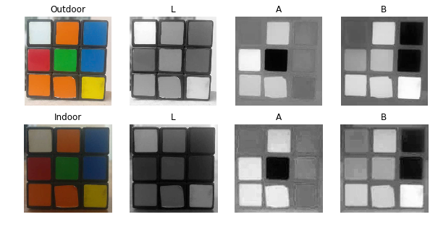
Color spaces. Practical aspect. Lab (CIELAB)
A great tutorial at learnopencv: https://www.learnopencv.com/color-spaces-in-opencv-cpp-python/
Perceptually uniform color space which approximates how we perceive color.

Slide 20
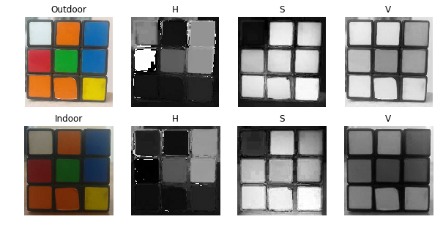
Color spaces. Practical aspect. HSV
A great tutorial at learnopencv: https://www.learnopencv.com/color-spaces-in-opencv-cpp-python/
Uses only one channel to describe color (H), making it very intuitive to specify color.
Why red is so different?

Slide 21
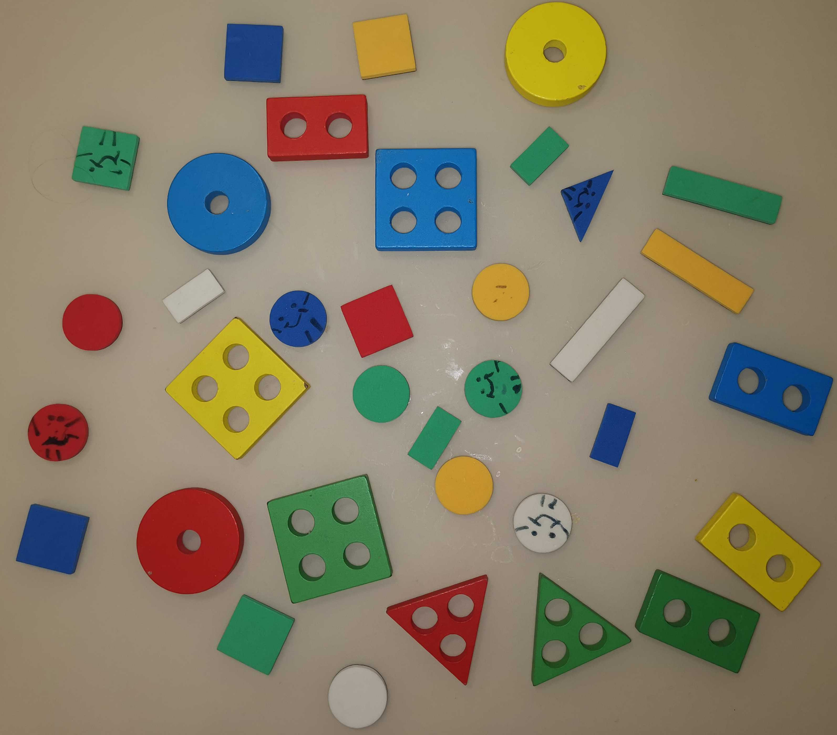
Colors: the exercise
1. Count the number of items 2. Count the number of green items 3. Count the number of rectangular items (including square ones) 4. Count the total number of holes

Slide 22
Outline
Colors
Edge-based & region-based segmentation
Superpixels
Homework 1

Slide 23
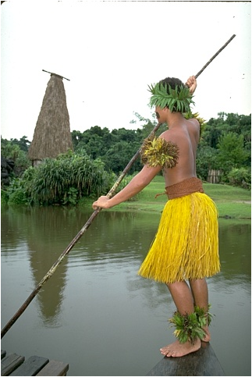
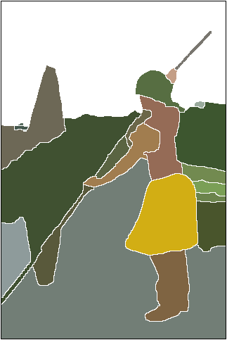
CV problems: Segmentation
Image source: https://www2.eecs.berkeley.edu/Research/Projects/CS/vision/grouping/resources.html

Slide 24
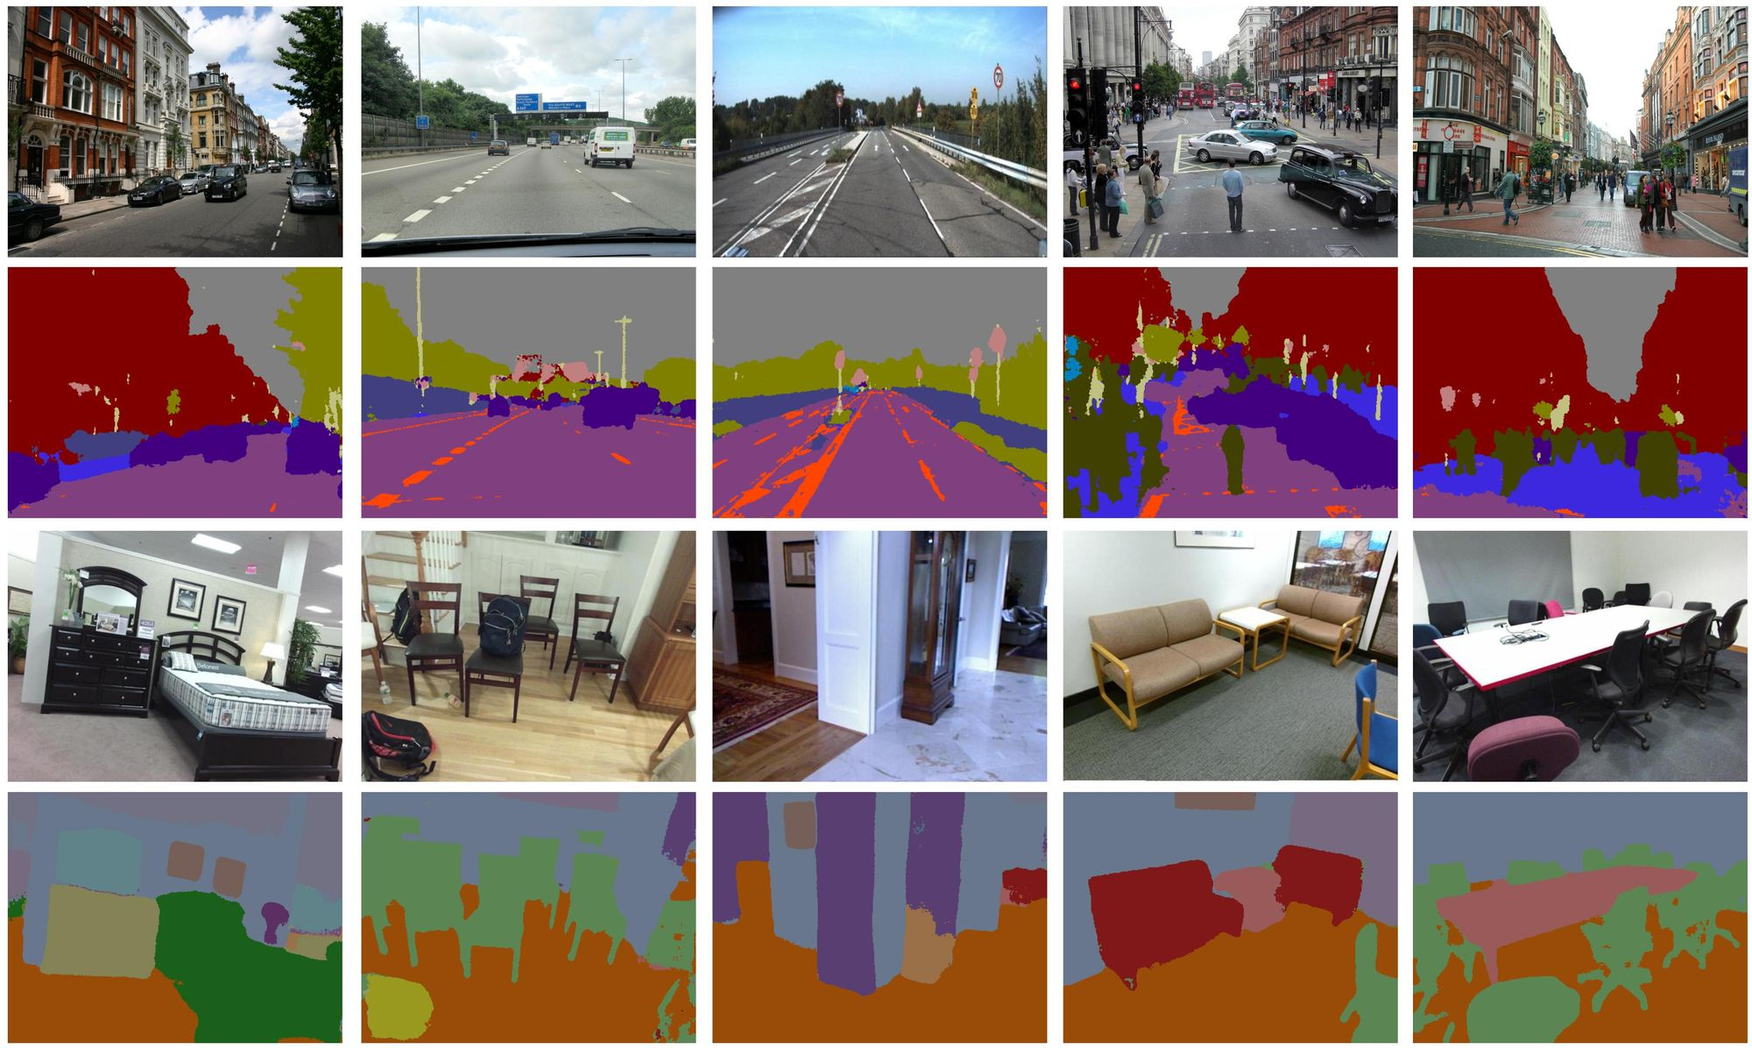
CV problems: Semantic segmentation
Image source: https://mi.eng.cam.ac.uk/projects/segnet/

Slide 25
Threshold-based segmentation
Convert to a 1-channel image (e.g. grayscale or a specific LAB / HSV channel)
Apply thresholding:
simple one side: im > th1
two-side: th1 < im < th2

Slide 26
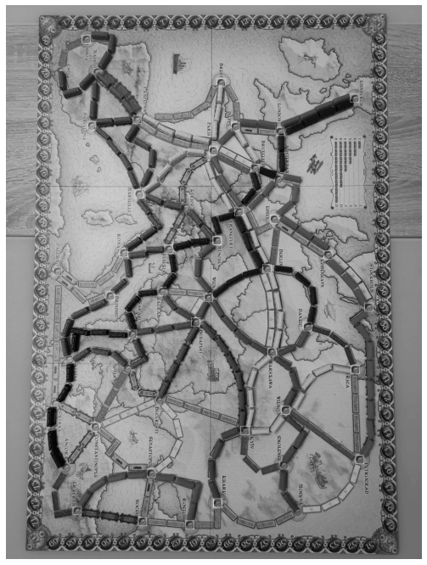

Threshold-based segmentation
Convert to a 1-channel image (e.g. grayscale or a specific LAB / HSV channel)
Apply thresholding:
simple one side: im > th1
two-side: th1 < im < th2

Slide 27
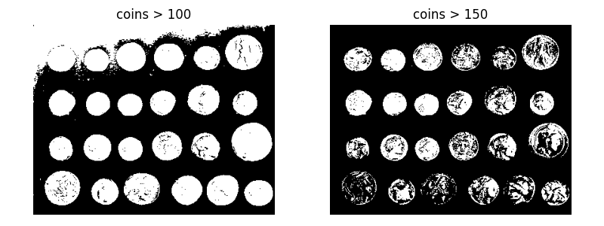
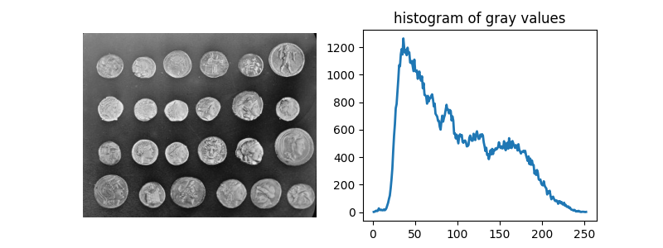
Threshold-based segmentation
But usually you do not have nice single-color objects, so this approach may fail
https://scikit-image.org/docs/dev/auto_examples/applications/plot_coins_segmentation.html#sphx-glr-auto-examples-applications-plot-coins-segmentation-py

Slide 28
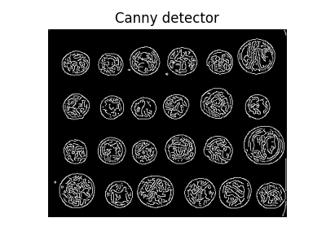
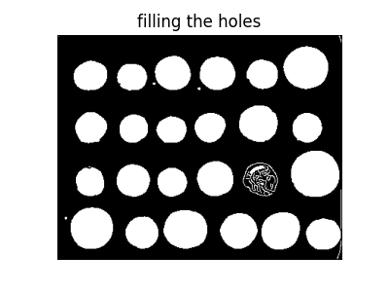
Edge-based segmentation
Step 1: find edges, e.g., via Canny
Step 2: add some morphology
https://scikit-image.org/docs/dev/auto_examples/applications/plot_coins_segmentation.html#sphx-glr-auto-examples-applications-plot-coins-segmentation-py

Slide 29
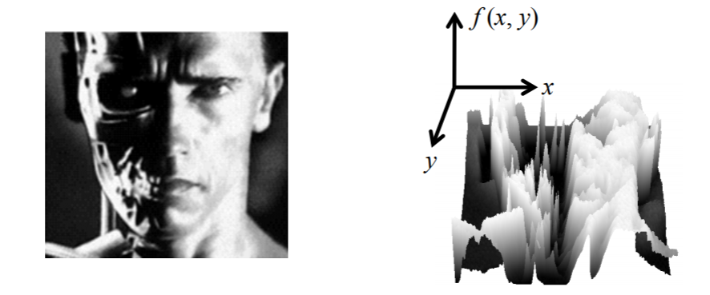
Region-based segmentation
Step 1: estimate gradients, e.g. via Sobel filter
Source: N. Snavely
https://scikit-image.org/docs/dev/auto_examples/applications/plot_coins_segmentation.html#sphx-glr-auto-examples-applications-plot-coins-segmentation-py

Slide 30
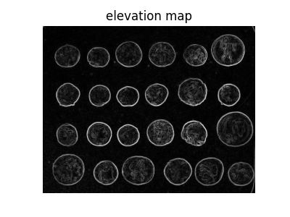
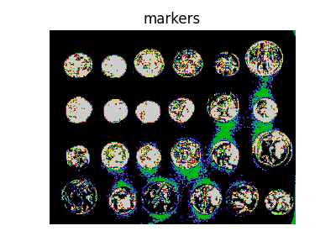
Region-based segmentation
Step 1: estimate elevation map, e.g. via Sobel filter
Step 2: select markers = starting points for flooding (here extreme grayscale values are used)
https://scikit-image.org/docs/dev/auto_examples/applications/plot_coins_segmentation.html#sphx-glr-auto-examples-applications-plot-coins-segmentation-py

Slide 31
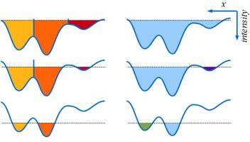
Watershed
Step 3: fill the elevation map with water of different “color” starting from every marker (to label every component)
https://svi.nl/watershed

Slide 32
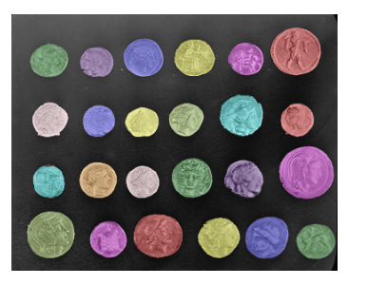
Region-based segmentation
Step 1: estimate gradients, e.g. via Sobel filter
Step 2: select markers for every object (here extreme grayscale values are used)
Step 3: apply watershed & label connected components
https://scikit-image.org/docs/dev/auto_examples/applications/plot_coins_segmentation.html#sphx-glr-auto-examples-applications-plot-coins-segmentation-py

Slide 33
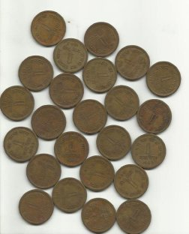
A more comprehensive example
Skimage test image is a quite simple one.
Let us go through an openCV tutorial for a more challenging coins image
https://docs.opencv.org/master/d3/db4/tutorial_py_watershed.html

Slide 34
Outline
Colors
Edge-based & region-based segmentation
Superpixels
Homework 1

Slide 35
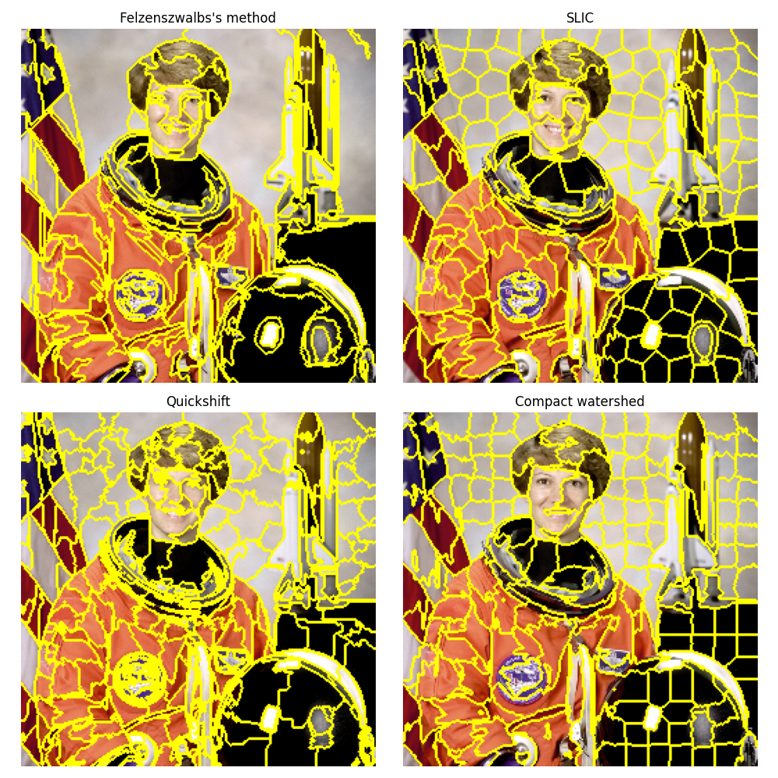
Superpixels
Idea: merge similar pixels into superpixels (=clusters)
SLIC: k-means in 5D space: location + rgb
https://scikit-image.org/docs/dev/auto_examples/segmentation/plot_segmentations.html#sphx-glr-auto-examples-segmentation-plot-segmentations-py

Slide 36

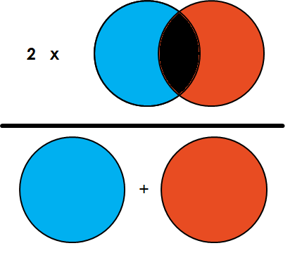
How to measure segmentation quality?
We’ve discussed simple unsupervised (=no actual masks) methods. Here subjective metrics are usually OK.
For semantic segmentation (=supervised) we need machine learning models, e.g. replacing k-means with kNN
If you have masks, then Dice or IoU can be used
https://towardsdatascience.com/metrics-to-evaluate-your-semantic-segmentation-model-6bcb99639aa2

Slide 37
Outline
Colors
Edge-based & region-based segmentation
Superpixels
Homework 1

Slide 38
Outline
Colors
Edge-based & region-based segmentation
Superpixels
Homework 1

Slide 39
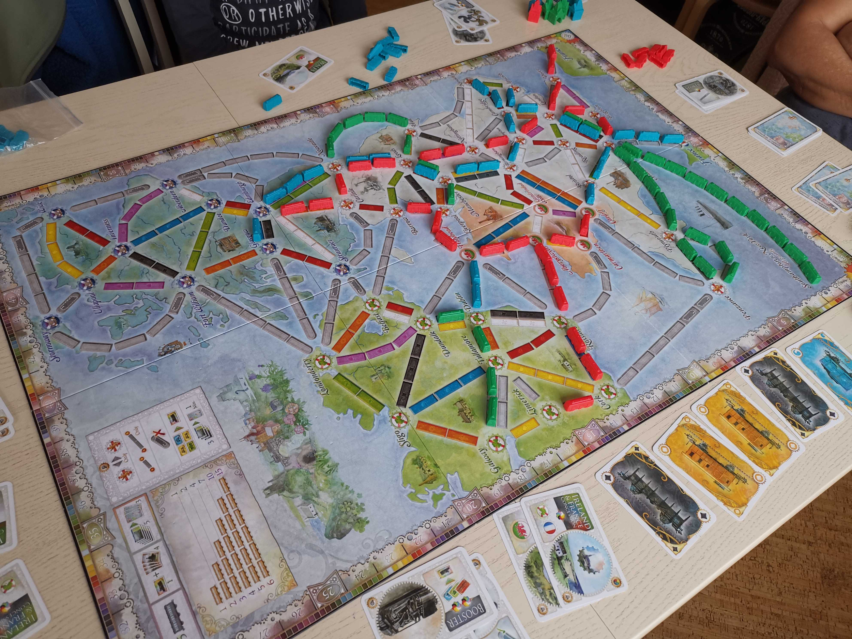
Homework 1
Do you know this game? If yes, what is the most boring part?

Slide 40
Homework 1
This is “Ticket to ride” board game!

Slide 41
Homework 1
And counting scores at the end of the game is really boring!
The goal of HW1 is to create an automated scoring system.

Slide 42
Homework 1
The goal of HW1 is to create an automated scoring system for Ticket to ride!
Challenges
1. Detect all town markers and trains
2. Split cells vs trains

Slide 43
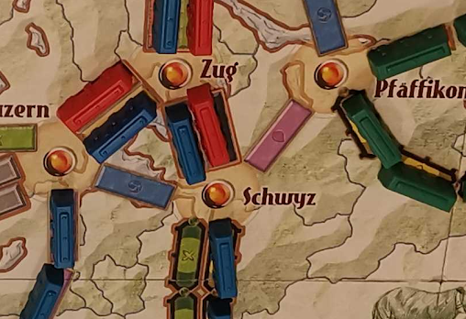
Homework 1
The goal of HW1 is to create an automated scoring system for Ticket to ride!
Challenges
1. Detect all town markers and trains
2. Split cells vs trains
3. Estimate the colors (e.g. take into account different light conditions)

